Slide 1



Slide 2
Overview – Class I
Review of course syllabus
Expectations for assignments and participation
Overview of the perspective taken in the course
Introduction to the use of i>clickers or reef polling
Introduction to sociological perspectives on health
  The Sociological Imagination and Structural Functionalism
Critique: Three models of health within the Canadian health care system
  Biomedical, Behavioural and Socioenvironmental

Slide 3

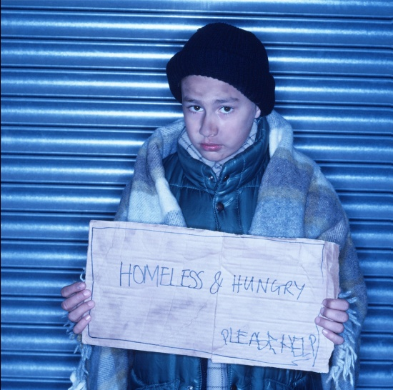
The Focus of the Course
Sociological perspectives are explored to consider how the following influence health and wellbeing:
social structures in society
social interactions and social roles
social inequalities
power relations within the health care system and society

Slide 4
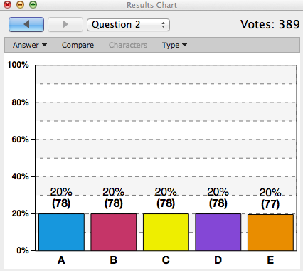
I-Clicker Questions
In this course, i-clicker questions are used as part of your participation mark.
Review
Concept clarification
Applying concepts to health issues
http://www1.iclicker.com/wp-content/uploads/2014/07/results-chart1.png

Slide 5
Participation – i-Clickers
i-Clicker remote (hand held device) – See instructions in Moodle
Process: You will need to register your personal i>clicker remote by class 2 as part of your participation mark for this class.
Reef Polling Process (on a cellphone or laptop): You will need to download the ap from the i-clicker website and register in Moodle
See: Moodle Answers.com
Participation: i-Clicker questions will be used to engage you in exploring course concepts. You must be present and respond to 75% of the questions in both the first and second half of each class.

Slide 6
I-Clicker Question 1 – Review (Practice)
In sociology, social structures refer to relative stable patterns of social behaviour within society that are observable and measurable such as:
a) social status or social class
b) gender
c) ethnicity
d) age
e) all of the above
*For the definition, see Segall & Fries, p. 215.

Slide 7
Sociology of Health & Wellbeing versus Medical Sociology (Segall & Fries, 2011, p. 23)
The Sociology of Health focuses on:
the social structures of society
self-health management (formal and informal health care)
good health and wellbeing
population and personal health
Sociology in Medicine
Insider perspective: Sociological perspectives - address questions of concern to medical professionals (a medicocentric view).
  Disease & illness
  Patients & Physicians
  (Individual health/disease)
Sociology of Medicine
Outsider’s perspective: Sociologists critique health care systems and impacts on individual health (e.g., medicalization).
  Illness & Sickness
  Patients & HC Professionals (Individual health/illness)

Slide 8
Sociological Perspectives
Sociological perspectives, social theory and critique are applied to explore current challenges that constrain ‘health for all’ or ‘health equity’.
From a sociological perspective we consider the interaction of
  individual agency and
  social structures within society.
Is health just an individual responsibility or is it also a collective responsibility?
What have you heard recently in the news that could be leading to unequal opportunities for health and wellbeing?

Slide 9
Format for the Class
Lecture
Cooperative Learning Activities
One Break of 15 min.

Slide 10
Course Syllabus
Course requirements
Group Facilitation Assignment
Group or Individual Scholarly Paper
  Outline
  Paper
Mid-term and final exams
Participation

Slide 11
Class Schedule (Tentative)
Sociological Perspectives:
  Conflict,
  Structural Functionalism,
  Feminist,
  Sociology of the Body
Three models of health
Measuring Health & Wellbeing (Personal versus Population Health)
The Factors that shape health & wellness; the Social Determinants
Sick People or Sick Societies? Politics, Public Policy and Health Inequities
Inequalities & Health Disparities:
  Socioeconomic Status (SES)
  Gender
  Race/Ethnicity
Medical Dominance & Medicalization
The Canadian & American Health Care (Illness Care) Systems
The Intersectional Model
Medical Pluralism & Complementary & Alternative Health Care

Slide 12
The Focus of the Course
How is health shaped by the conditions of everyday life?
Agency
Individual choices
  Self-care & Good Health
Lay Health Beliefs
Experiences of health & illness
Social Structures
Socially patterned behaviour and inequalities by income, ethnicity, gender & age
Formal Health Care System
Informal systems of care (family & friends)
Medical pluralism & Complimentary and Alternative Health Care
Socioeconomic & Political Context
Social Environment
Economic Environment
Social Policies & the Political Environment

Slide 13
Interests
Turn to your neighbour and introduce yourself.
  Where you are from?
  Your year of study and major?
Name one thing that interests you about the course.

Slide 14

Societies and Health
Should we focus on sick people or sick societies?
What do we mean by societies?
  Aggregates of people
  Social structures
  Social & Political contexts

Slide 15
Critique: Three Models of Health
Labonte (1993)
Dr. Ronald Labonte, a Canadian sociologist suggests that three models of health are prominent within the Canadian health care system :
Biomedical Model (a focus on formal health care services and individual responsibility)
Behavioural Model (a focus on healthy lifestyles and individual responsibility)
Socioenvironmental Model (a focus on the conditions of everyday life that enable or constrain health along with individual agency)
How do your views line up with these views of health?

Slide 16
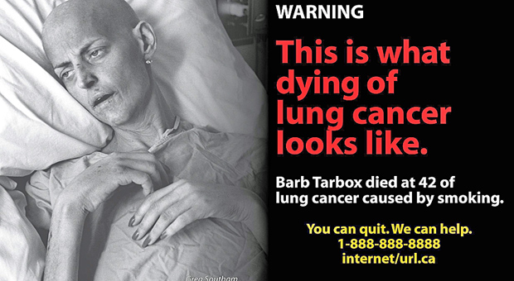


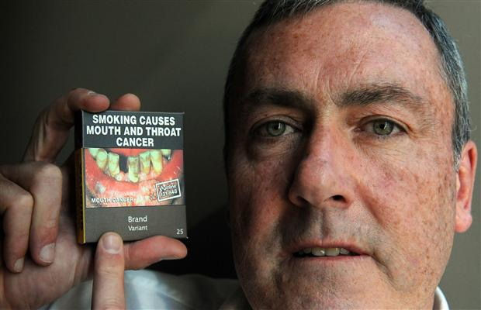


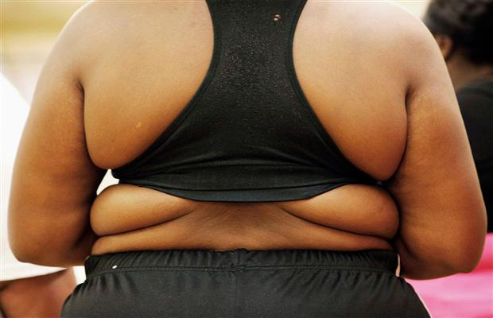






Dominant messages about health in the media

Slide 17
i>Clicker – Question 2 (Practice)
What makes people healthy? What is most important from your perspective?
Access to health care services and medical treatment as well as biological and genetic factors (Biomedicine)
Healthy eating and physical activity (Individual Behaviour)
Healthy social, economic, political and physical environments that support population health (Socioenvironmental)
Purchasing health-care products and services to promote health (Health Behaviour and Medical Consumerism)
All of the above

Slide 18
What is Good Health?
Antonovsky (1996, cited in Segall & Fries Ch. 1 p 3-4)
“It is wise to see models, theories, constructs, hypotheses and even ideas as heuristic devices, not as holy truths.”
Critiqued the biomedical focus on illness and disease (pathogenic focus)
Promoted a focus on good health (salutogenic focus) – a focus on the meaning of good health and the social factors that contribute to the successful pursuit of health and wellness.

Slide 19
Salutogenesis = Good Health
Antonovsky 1996, cited in Segall & Fries Ch. 1 p 3-4
Proposed a focus on Salutogenesis (good health) instead of Pathogenesis:
  Social conditions facilitating health-protective behaviours
  The meaning of good health and wellbeing
  Sociology of Health

Slide 20

Your Perspective

Slide 21
Activity
What do we mean by being healthy?
Turn to your neighbour and discuss:
When you think about “being healthy” – what comes to mind?
What do you do to stay healthy?
Is health an individual responsibility? A societal responsibility? or a shared responsibility? Why?

Slide 22

Why does it matter how we define Health? WHO, 1986; Segall & Fries p. 6-7
Ottawa Charter definition of Health:
“To reach a state of complete physical, mental and social well-being, an individual or group must be able to identify and to realize aspirations, to satisfy needs, and to change or cope with the environment.
Health is a resource for everyday life, not the objective of living. Health is a positive concept
emphasizing social and personal resources, as
Well as physical capacities.
Therefore, health promotion is not just the
responsibility of the health sector, but goes beyond healthy lifestyles to well-being” (WHO, 1986, p. 2)

Slide 23
A Sociological View of Health
A focus on the social, cultural, economic, and political environmental contexts influencing health (Socioenvironmal)
Not just the absence of disease or a biological /physiological state (Biomedical)
Not just healthy lifestyles and individual behaviour or individual choices (Behavioural)
Includes personal and social resources (Agency & Structure)
Well-being is a broader term than health and it includes the concept of “Good Health”

Slide 24
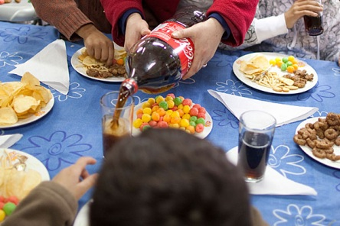
Social Construction of Health
Sociologists suggest that health is socially constructed:
Social interactions in everyday life construct subjective meanings of “good health” and the social reality that is “society”.
A sociological view of health takes into account:
Individual self-care and differences
Social, cultural, economic and political contexts
The healthiness of a society
.

Slide 25
i>Clicker Question 3
Sociology of Health includes a focus on the following except:
the meaning of good health and wellbeing
social interactions and cultural contexts
disease and illness from the insider perspective
social structures and societal conditions
all of the above

Slide 26

Getting the Most out of the Course

Slide 27
Moodle
What to look for in Moodle:
  Power Point notes
  Required Readings (listed in Course Outline)
  Optional Readings
  Schedule for Group Facilitation sessions
    Class Discussion Questions
    Assigned Reading
  Guest speakers
  Base Groups
  Resources, Glossary & Web links

Slide 28
Discussion
What do we learn from group discussion?
Why is diversity within groups helpful?

Slide 29
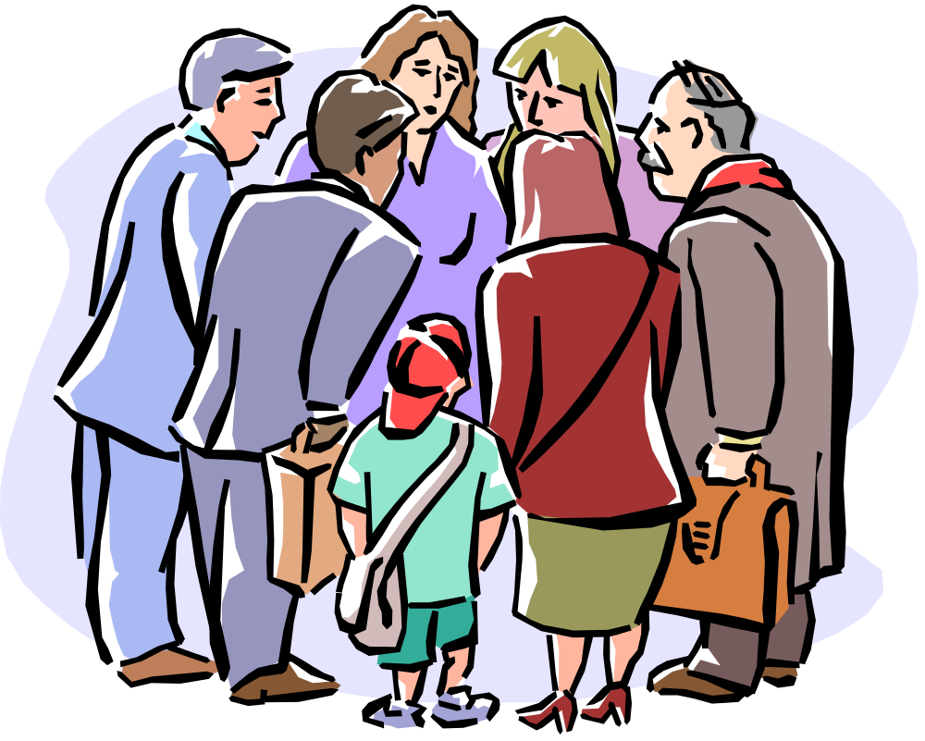
What is a sociological perspective?
Examples?

Slide 30
References
Segall, A. & Fries, C. (2011). Introducing Health Sociology Ch. 1.
In A. Segall & C. Fries. Pursuing health and wellness: healthy
societies, healthy people. (pp. 3-27). Don Mills: Oxford
University Press.
World Health Organization (1986). Ottawa Charter for Health
Promotion. Ottawa: WHO and Canadian Public Health
Association.
Photos: Lethbridge Herald Calgary Herald, Edmonton Journal, and Saskatoon Star Phoenix 2011-2014

